Slide 1
Conversational AI

Slide 2




Team 8
GIRISH GUNTUKU
Midhun Kumar Kurapati
Cherukuru Chaithanya
Pappu Sah

Slide 3
Topics
What is Artificial Intelligence
Limits of Artificial Intelligence
AI Techniques
Amazon Echo
how does it work
Speech-to-text and Intent parsing
Cherukuru Chaithanya

Slide 4
What is Artificial Intelligence?
Using computer to solve problems Or make automated decisions For tasks that,when done by humans Typically require Intelligence
Cherukuru Chaithanya

Slide 5
Limits of Artificial Intelligence
“Strong” Artificial Intelligence
Computers thinking at a level that meets or surpasses people
Computers engaging in abstract reasoning & thinking
This is not what we have today
There is no evidence that we are close to Strong AI
“Weak” Pattern-Based Artificial Intelligence
Computers solve problems by detecting useful patterns
Pattern-based AI is an Extremely powerful tool
Has been used to automate many processes today
Driving, language translation
This is the dominant mode of AI today
Cherukuru Chaithanya

Slide 6
Major AI Approaches
Two Major AI Techniques
Logic and Rules-Based Approach
Machine Learning (Pattern-Based Approach)
Cherukuru Chaithanya

Slide 7
Logic and Rules-Based Approach
Logic and Rules-Based Approach
Representing processes or systems using logical rules
Top-down rules are created for computer
Computers reason about those rules
Can be used to automate processes
Example within law – Expert Systems
Turbotax
Personal income tax laws
Represented as logical computer rules
Software computes tax liability
Cherukuru Chaithanya

Slide 8
Machine Learning (Pattern based)
Machine Learning (ML)
Algorithms find patterns in data and infer rules on their own
”Learn” from data and improve over time
These patterns can be used for automation or prediction
ML is the dominant mode of AI today
Midhun Kurapati

Slide 9
Machine Learning Main Points
Learning
Pattern Detection
Data
Self-Programming
Midhun Kurapati

Slide 10
Example: Email Spam Filter
System detects patterns in Email About likely markers of spam
Detected Pattern Emails with “Earn Cash” More likely to be spam email
Can use such detected patterns to make automated decisions about future emails
Algorithm improves in performance In auto-identifying spam
As it is able to examine more data And find additional indicia of spam
Algorithm is “learning” over time from additional examples
Midhun Kurapati

Slide 11

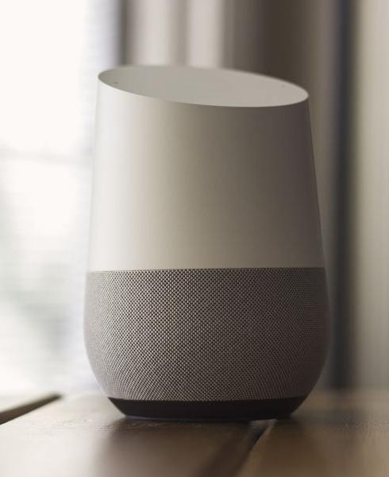
Machine Learning Uses
Computer Translation Amazon Alexa
Midhun Kurapati

Slide 12
What is the Amazon Echo
Amazon introduced the Echo smart speaker at the end of 2014.
It's a standalone Bluetooth speaker with an array of "far-field" microphones that can hear you at a moderate distance plus a Wi-Fi connection to the Amazon cloud.
You wake the Echo up by saying "Alexa," the name of Amazon's virtual assistant (you can change this wake word to "Amazon," "Echo" or "Computer," if you like).
Midhun Kurapati

Slide 13
how does it work
Whenever you ask Alexa a question or give her a command, the Echo records the audio and uploads the snippet to Amazon's cloud servers.
Those servers translate the audio into text, then figure out the best way for Alexa to answer.
That info gets sent back to your Echo speaker, where Alexa translates the text back into a spoken response. All of this happens in about a second.
Pappu Sah

Slide 14
Alexa is always listening to me?
Sort of. The Echo is always listening for the wake word, but it only starts recording and transmitting audio once it thinks it hears it.
Echo devices indicate this with that blue ring of light -- when it lights up, that means Alexa is recording and uploading what it hears in order to figure out how to respond.
Pappu Sah

Slide 15
Speech-to-text and Intent parsing
Speech to Text (STT)
Speech to Text (STT) software is used to take spoken words, and turn them into text phrases that can then be acted on.
Intent parser
An intent parser is software which identifies what the user’s intent is based on their speech. An intent parser usually takes the output of a Speech to Text (STT) engine as an input.
Pappu Sah

Slide 16
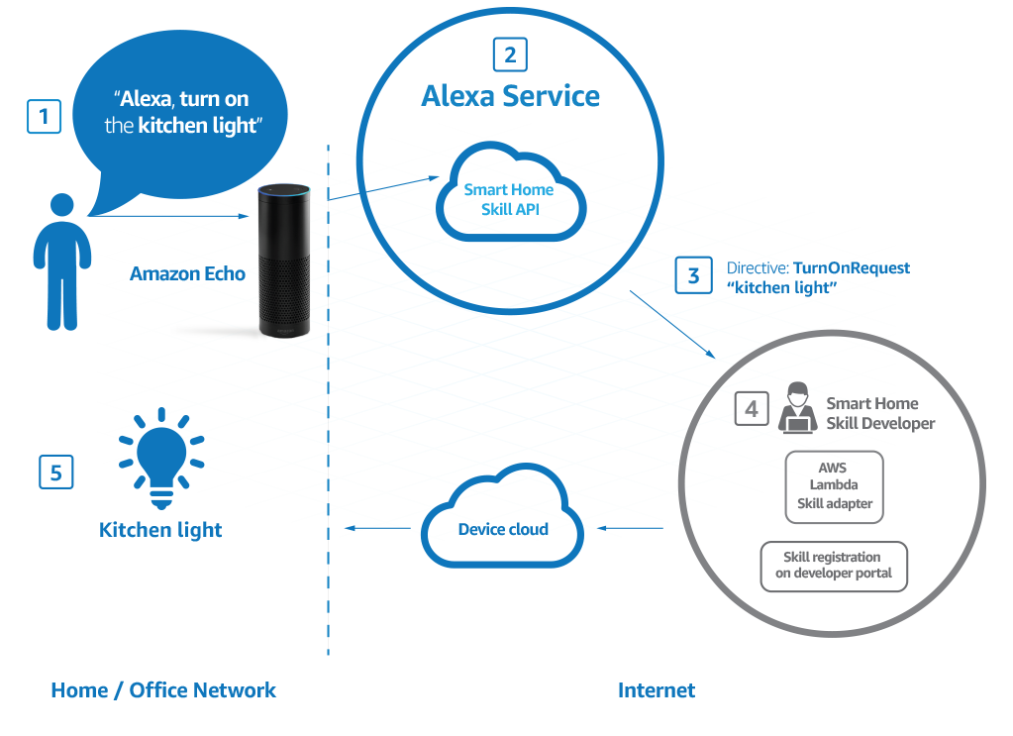
Pappu Sah
Notes:
1) Wake word processing (“Alexa”) is done on the device which is running a local process to detect this word.
2) Once the wake word is triggered audio recording is triggered on the device and streamed to AWS (more specifically the Alexa Voice Service) where the content is processed and a skill is triggered.
TLDR: The echo processes the “wake word”, audio recording/streaming, text-to-speech on the device (client-side). The speech-to-text, intent parsing, and skill triggering is all done on the server.

Slide 17

GIRISH GUNTUKU

Slide 18


Slide 19


